Slide 1
Data Engineering with GCP
Big Table & Firestore

Slide 2
Revision History
Version | Date | Author | Reviewed by | Comments
1.0 | 15-Apr-2024 | Sneha Arumugam |  | Initial Version

Slide 3
Build Data Storage Solutions NoSQL Databases
Use Cloud Firestore And Big Table In Practice

Slide 4

BIGTABLE

Slide 5
Introduction to Bigtable
Cloud Bigtable is a high-speed, fully managed NoSQL database service that offers massive scalability.
As a sparsely populated table, Cloud Bigtable can scale to billions of rows and thousands of columns, allowing storage of terabytes to petabytes of data.
Each row has an indexed single value called the row key.
Bigtable is well-suited for handling large volumes of single-keyed data with minimal latency.

Slide 6
Bigtable
Fully Managed database service
For large analytical and operational workloads
Fast and performant
Seamless scaling and replication
Simple and integrated
Designed with a storage engine for machine learning applications
Easily integrates with Google Cloud services like BigQuery and the Apache ecosystem.
Developed by Google in 2004
One of the initial NoSQL offerings
Scalable NoSQL Database
Notes:
https://cloud.google.com/bigtable
Consistent sub-10ms latency—handle millions of requests per second
Seamlessly scale to match your storage needs; no downtime during reconfiguration
Fully managed service that integrates easily with big data tools like Hadoop, Dataflow, and Dataproc. Plus, support for the open source HBase API standard makes it easy for development teams to get started.
Designed with a storage engine for machine learning applications leading to better predictions

Slide 7
Bigtable Features
High performance with minimal latency
Cloud Bigtable stores massive amounts of data in a key-value format, with throughput that scales linearly—enabling higher queries per second (QPS) simply by adding more nodes.
Cluster resizing is seamless, with no downtime.
Scale effortlessly from thousands to millions of reads and writes per second, with throughput that can be dynamically adjusted by adding or removing cluster nodes.
Offers flexible, automated replication to optimize performance for any workload
Provides automatic replication with eventual consistency, ensuring a high availability SLA of 99.99% for instances configured with multi-cluster routing.
It has been thoroughly tested with major Google products like Gmail, Google Search, and Google Maps.

Slide 8
Use Cases
Ideal for applications that need very high throughput and scalability for key/value data
Supports batch MapReduce operations, stream processing and analytics, as well as machine learning applications.
Examples –
Time-series data
Marketing data
Financial data
Internet of Things data
Graph data
Notes:
Cloud Bigtable is ideal for applications that need very high throughput and scalability for key/value data, where each value is typically no larger than 10 MB
Time-series data, such as CPU and memory usage over time for multiple servers.
Marketing data, such as purchase histories and customer preferences.
Financial data, such as transaction histories, stock prices, and currency exchange rates.
Internet of Things data, such as usage reports from energy meters and home appliances.
Graph data, such as information about how users are connected to one another.

Slide 9
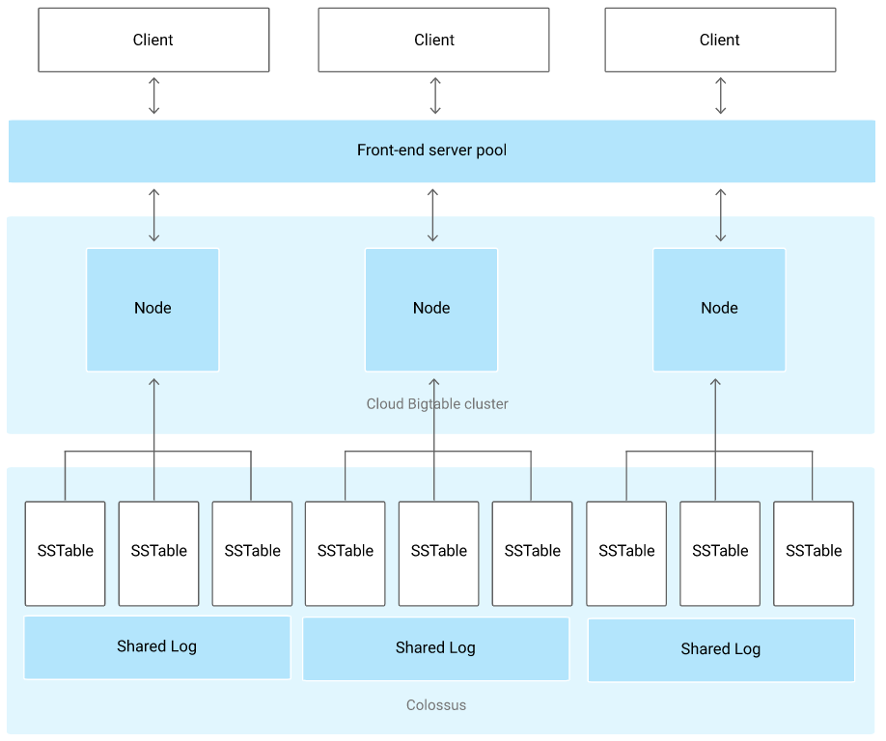
Cloud Bigtable Architecture
All client requests pass through a front-end server before being directed to a Cloud Bigtable node.
Nodes are organized into a Cloud Bigtable cluster, while a Cloud Bigtable instance serves as a container for the cluster.
Additional clusters can be added for data replication.
A Cloud Bigtable table is divided into blocks of contiguous rows, known as tablets, which are stored on Colossus, Google's file system, in SSTable format.
In addition to SSTable files, all write operations are recorded in Colossus's shared log.
Data is not stored directly within Cloud Bigtable nodes; instead, each node contains pointers to a collection of tablets.
Notes:
Cloud Bigtable Architecture
Cloud Bigtable is a NoSQL database that is designed for storing large amounts of structured data. It is a distributed database that is highly scalable and fault-tolerant.
Client Requests
All client requests go through a front-end server before they are sent to a Cloud Bigtable node. The front-end server is responsible for routing requests to the appropriate nodes and for load balancing.
Nodes and Clusters
Nodes are the basic building blocks of Cloud Bigtable. Each node is a machine that runs the Cloud Bigtable software. Nodes are organized into clusters, and each cluster can have multiple nodes.
Instances
A Cloud Bigtable instance is a container for a cluster. An instance can have multiple clusters, and each cluster can have multiple nodes.
Data Replication
Cloud Bigtable can be configured to replicate data across multiple clusters. This provides high availability and data durability.
Tables and Tablets
A Cloud Bigtable table is a collection of data. Tables are divided into blocks of contiguous rows, called tablets. Each tablet is stored on a single node.
SSTable Format
Tablets are stored in Colossus, Google's file system, in SSTable format. SSTables are immutable files that are used to store data in a columnar format.
Shared Log
In addition to the SSTable files, all writes are stored in Colossus's shared log. The shared log is used to keep track of all changes that are made to the data.
Data Not Stored in Nodes
Data is not stored in Cloud Bigtable nodes. Instead, each node stores pointers to a set of tablets. This allows Cloud Bigtable to scale to very large sizes without having to store all of the data on a single node.
Cloud Bigtable is a highly scalable, fault-tolerant, and durable NoSQL database that is ideal for storing large amounts of structured data.

Slide 10
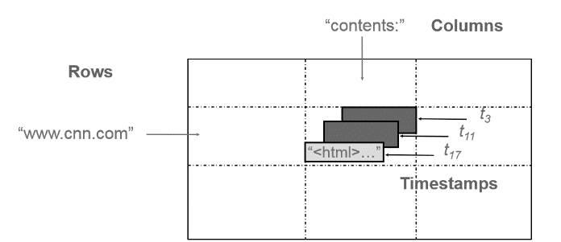
Data Model
Bigtable is a sparse, distributed, multi-level map indexed by a combination of row, column, and timestamp values.
It is represented as:
{ row : {
column_family : {
column : {
timestamp : value
}
}
}
}
Notes:
The picture shows Bigtable can store multiple values (instances) of data in a single cell using timestamp, it shows multiple versions of html pages stored at different values of timestamp. This feature makes Bigtable a truly multidimensional map.
4o mini
Row:Row keys are arbitrary strings up to 64 KB of size. Bigtable maintains data in lexicographical order of row key. Atomic access is provided to any of the columns in a row. Multiple contiguous rows grouped together is called a tablet.
Column:Column keys are also strings having a two level naming structure which has column family and optional qualifiers.
Column name → family : optional_qualifier
Column family are the basic unit of access control. Optional qualifiers on the other hand do provide valuable information for various operations on sorting, grouping etc.
TimeStamp:Since Bigtable can store multiple versions of data in a cell it uses timestamp values to index these multiple versions. Timestamp is a 64-bit integer value. This timestamp value can be set by the Bigtable or be explicitly set by the clients. Timestamps make it possible for clients to access most recent values or use values among a specific range of timestamp.
Explain Student,Course Schema in paint from pdf

Slide 11
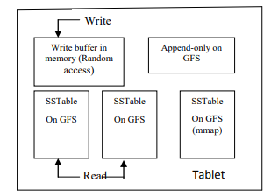
Tablet Representation
A tablet is a collection of contiguous rows grouped together
The SSTable is a file of key/value string pairs, sorted by keys
Append only log is stored on GFS
Notes:
Tablet is contiguous row grouped together. Now we focus on the internal details of the tablet as to how the tablet is represented internally. It consists of an append only log, an in memory buffer and a couple of SSTable all stored on GFS.
The SSTable is a file of key/value string pairs, sorted by keys. An SSTable provides a persistent, ordered immutable map from keys to values, where both keys and values are arbitrary byte strings[7].One machine holds roughly a hundred servers. Append only log is stored on GFS. It just holds the entry of all the mutations .This is mostly used for recovery purpose. All the mutations are appended to a log. There is one append log per tablet server. When a write request comes in that request is first put into a queue, from that queue a thread is invoked which then that thread writes the data to GFS. Once write is committed to GFS the same log is then mirrored to in memory buffer. This buffer holds all the writes that have not been committed to the disk file. Data on disk is conceptually merged in SSTable. Some reads may find the required in memory itself and some may have to search the data on SSTable if they don’t find it in the memory. When this memory fills up the data on this memory is dumped into a SSTable file. Eventually it may be decided to combine all this small table into one large SSTable on disk. Bloom filters are used to find whether data can be present for a particular row column combination in SSTable

Slide 12
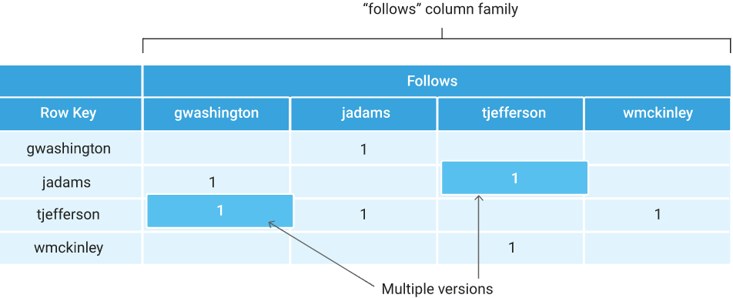
Storage Model
Stores data in massively scalable tables
Table is composed of Rows (describes entity) and Columns (value for each row)
Each row is indexed by a single row key
Related columns are typically grouped together into a column family
Column is identified by a combination of the column family and a column qualifier
Notes:
Each row in Cloud BigTable is indexed by a single row key; or we can say a single value in each row is indexed. This value is called the row key. This row key can be a unique identifier.
And each column is identified by a combination of column-family and column-qualifier. Here, column-qualifier is a unique name within the column-family. One column-family can contain ..

Slide 13
Instances
A Bigtable instance serves as a container for your data.
Instances can have one or more clusters distributed across different zones.
Each cluster contains at least one node.
A table is associated with an instance, not with a specific cluster or node.
If your instance includes more than one cluster, it is utilizing replication.

Slide 14
Instances
An instance has a few important properties that you need to know about:
Storage Type (SSD or HDD):
When creating an instance, you must choose whether the instance's clusters will store data on hard disk drives (HDD) or solid-state drives (SSD).
This selection is permanent, and all clusters within the instance must use the same type of storage.
Application Profiles:
The method by which your applications connect to the instance's clusters is governed by application profiles for instances that utilize replication.

Slide 15
Clusters
A cluster represents the Bigtable service in a specific geographic location.
Each cluster is associated with a single Bigtable instance, which can have clusters in up to eight regions.
Clusters are situated in individual zones.
An instance can have clusters in a maximum of eight regions where Bigtable is supported.
Each zone within a region can accommodate only one cluster.
Bigtable instances that contain only one cluster do not utilize replication.

Slide 16
Nodes
Each cluster in an instance consists of one or more nodes, which are the compute resources that Bigtable utilizes to manage your data.
Bigtable divides all data in a table into separate tablets.
These tablets are stored on disk, independently from the nodes but within the same zone as the nodes.
Each node is responsible for:
Tracking specific tablets stored on disk.
Managing incoming read and write requests for its tablets.
Conducting maintenance tasks on its tablets.

Slide 17
NoSQL SOLUTIONS (CLOUD FIRESTORE)

Slide 18
Cloud Firestore
Fully Managed Document database
Development of mobile, web, and IoT apps
Built-in live synchronization and offline mode
Effortless integration with Firebase and other Google Cloud services.
Supports ACID transactions
Automatic scaling
High availability ranging from 99.99% to 99.999%.
Robustly consistent data replication.
Easy and flexible, featuring a pay-as-you-go pricing model.
Scalable and serverless document Database
Notes:
https://cloud.google.com/firestore
Cloud Firestore is a fully managed, NoSQL document database that can be used to develop mobile, web, and IoT applications. It offers a number of features that make it a good choice for these types of applications, including:
Built-in live synchronization and offline mode: Cloud Firestore automatically synchronizes data changes across all devices in real time, so users can always access the latest data. It also supports offline mode, so users can continue to access data even when they are not connected to the internet.
Seamless integration with Firebase and Google Cloud services: Cloud Firestore integrates seamlessly with other Firebase services, such as Firebase Auth and Firebase Storage. It also integrates with other Google Cloud services, such as Google Cloud Storage and Google Cloud BigQuery.
Supports ACID transactions: Cloud Firestore supports ACID transactions, which guarantee that all changes to data are either committed or rolled back atomically. This ensures that data is always consistent and reliable.
Automatic scaling: Cloud Firestore automatically scales to meet the needs of your application. You don't need to worry about provisioning or managing servers.
High availability of 99.99–99.999%: Cloud Firestore is highly available, with a guaranteed uptime of 99.99–99.999%. This means that your application will be available to users most of the time.
Strongly consistent data replication: Cloud Firestore data is strongly consistent, which means that all users see the same data at the same time. This is important for applications that require real-time data synchronization.
Simple and flexible with pay as you go: Cloud Firestore is simple to use and can be provisioned and scaled on demand. You only pay for the resources that you use.
Overall, Cloud Firestore is a powerful and versatile document database that is well-suited for developing mobile, web, and IoT applications. It offers a number of features that make it a good choice for these types of applications, including built-in live synchronization and offline mode, seamless integration with Firebase and Google Cloud services, support for ACID transactions, automatic scaling, high availability, strongly consistent data replication, and simple and flexible pricing.

Slide 19
Cloud Firestore Features
Serverless
No scheduled maintenance windows or downtime.
Powerful query engine
Firestore enables you to execute complex ACID transactions on your document data.
Libraries for popular languages
Node.js, Java, Go, Ruby, and PHP
Security
Firestore integrates effortlessly with Firebase Authentication and the Identity Platform.
Multi-region replication
Datastore mode
Firestore supports the Datastore API
Notes:
Firestore and App Engine: You can't use both Firestore and Cloud Datastore in the same project, which might affect apps using App Engine. Try using Firestore with a different project if you need to use Datastore
Serverless : Fully managed, serverless database that effortlessly scales up or down to meet any demand, with no maintenance windows or downtime.
Powerful query engine : Firestore allows you to run sophisticated ACID transactions against your document data. This gives you more flexibility in the way you structure your data.
Libraries for popular languages : Focus on your application development using Firestore client-side development libraries for Web, iOS, Android, Flutter, C++, and Unity. Firestore also supports traditional server-side development libraries using Node.js, Java, Go, Ruby, and PHP.
Security : Firestore seamlessly integrates with Firebase Authentication and Identity Platform, to enable customizable identity-based security access controls and enables data validation via a configuration language.
Multi-region replication : With automatic multi-region replication and strong consistency, your data is safe and has a 99.999% availability guarantee, even when disasters strike.
Datastore mode : Firestore supports the Datastore API. You won't need to make any changes to your existing Datastore apps, and you can expect the same performance characteristics and pricing with the added benefit of strong consistency. Existing Cloud Datastore databases will be automatically upgraded to Firestore starting in 2021.

Slide 20
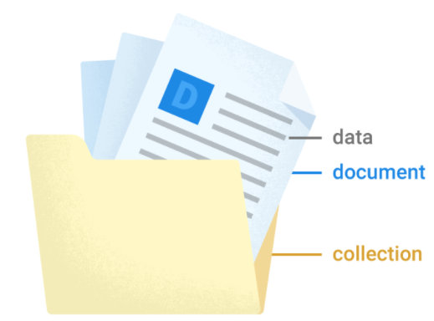
Data Model
Firestore is a NoSQL, document-oriented database that stores data in documents organized into collections.
Each document consists of a set of key-value pairs and is optimized for handling large collections of small documents.
All documents must reside within collections, and documents can also contain subcollections and nested objects.

Slide 21
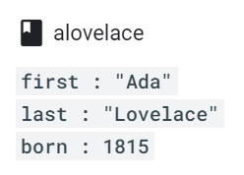
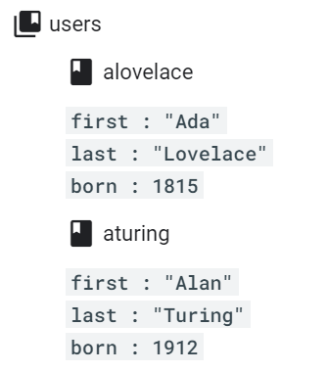
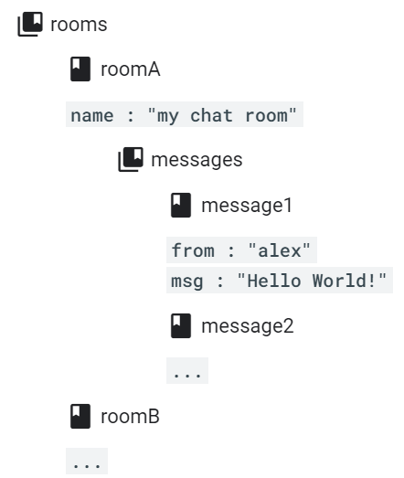
Data Model
Example
Document
Collection
Subcollection
Notes:
A document representing a user alovelace. Documents looks like a json files, but documents support extra data types and are limited in size to 1 MB.
Documents live in collections, which are simply containers for documents. As shown, we have a users collection to contain users alovelace and aturing (nothing but douments)
A subcollection is a collection associated with a specific document. In this example, a subcollection called messages for every room document in our rooms collection

Slide 22
Firestore in Native mode
Firestore is the next major iteration of Datastore, representing a rebranding of the product.
It is a NoSQL document database designed for automatic scaling, high performance, and simplified application development.
Firestore introduces several new features, including:
A new, strongly consistent storage layer
A collection and document data model
Real-time updates
Mobile and web client libraries
Notes:
Firestore is the next major iteration of Datastore, representing a rebranding of the product.
It is a NoSQL document database designed for automatic scaling, high performance, and simplified application development.
Firestore introduces several new features, including:
A new, strongly consistent storage layer
A collection and document data model
Real-time updates
Mobile and web client libraries

Slide 23
Firestore in Datastore mode
Firestore in Datastore mode leverages Datastore's system behavior while utilizing Firestore's storage layer, eliminating several limitations of Datastore
Eventual consistency: Queries in Datastore mode become strongly consistent unless you explicitly request eventual consistency.
Queries within transactions no longer need to be ancestor queries.
Transactions are no longer restricted to 25 entity groups.
Writes to an entity group are no longer capped at one per second.
Notes:
Firestore in Datastore mode leverages Datastore's system behavior while utilizing Firestore's storage layer, eliminating several limitations of Datastore:
Eventual consistency: Queries in Datastore mode become strongly consistent unless you explicitly request eventual consistency.
Queries within transactions no longer need to be ancestor queries.
Transactions are no longer restricted to 25 entity groups.
Writes to an entity group are no longer capped at one per second.

Slide 24
Choosing a Database mode
When setting up a new Firestore database, you need to choose a database mode.
You can have both Datastore mode and Native mode databases in the same project, but each database will be of a single type.
Use Firestore in Datastore mode for new server projects.
Use Firestore in Native mode for new mobile and web apps.
Notes:
When you create a new Firestore database, you must select a database mode. You can have both Datastore mode and Native mode databases in the same project, but each database will be of a single type. We recommend the following when choosing a database mode:
Use Firestore in Datastore mode for new server projects.
Firestore in Datastore mode allows you to use established Datastore server architectures while removing fundamental Datastore limitations. Datastore mode can automatically scale to millions of writes per second.
Use Firestore in Native mode for new mobile and web apps.
Firestore offers mobile and web client libraries with real-time and offline features. Native mode can automatically scale to millions of concurrent clients.

Slide 25
Structure Data
Documents
Multiple collections
Subcollections within documents
When organizing your data in Cloud Firestore, you have several options to choose from:
Notes:
Nested data in documents
You can nest complex objects like arrays or maps within documents.
Subcollections
You can create collections within documents when you have data that might expand over time
Root-level collections
Create collections at the root level of your database to organize disparate data sets

Slide 26
Build Data Storage Solutions NoSQL Databases
Use Cloud Firestore And Big Table In Practice

Slide 27
Thank You

